Slide 1

Hate Speech Detection
Exploratory Data Analysis and Model Proposal
09/05/23

Slide 2

Agenda
Problem Statement
Assumptions
EDA and Featurization
Proposed Models

Slide 3
Business Understanding
Hate Speech Detection is a task of sentiment classification.
Censor hate speech posts.
These aren’t in line with our policy.
Defined as discriminatory messages based on identity.
Earn user’s trust as safe and accessible platform.
Raise advertiser confidence in brand image and platform.
Increase ad revenue.

Slide 4
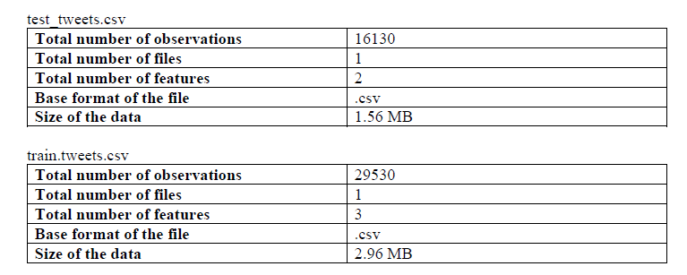
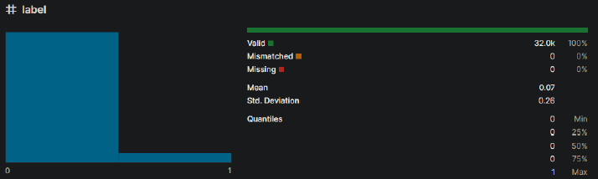
Dataset and Assumptions
The data is derived from real tweets.
The training data is labelled correctly.
The training and test data are from the same domain.
The amount of hate speech compared to non-hate speech reflects the proportion on the platform (see below)..
Tweets are below the limit of 200 characters and are formatted in the same way.
Dataset split into training and testing data.

Slide 5
Extra Training Features
What factors are indicators of hate speech?
Word count and avg. length:
some speech patterns are indicative of anger.
Hashtags:
hashtags might be associated with hate speech.
Exclamation marks:
can be an indicator of rage.
Question marks:
people often use rhetorical questions to show anger.
Uppercase usage:
can be an indicator of anger.
Sentiment:
there might be a link between use of negative words and hate speech.

Slide 6
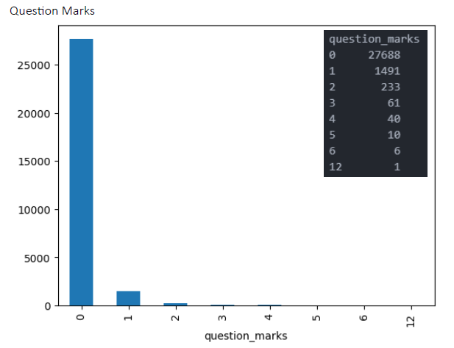
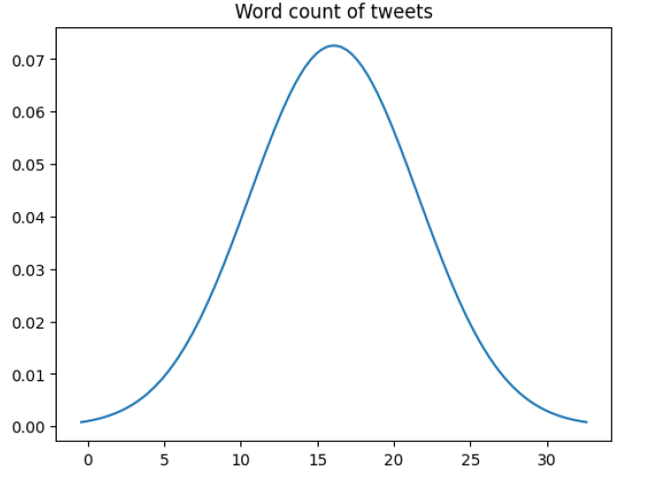
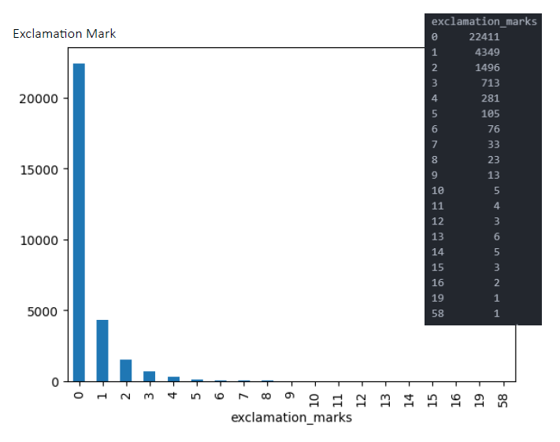
Extra Training Features

Slide 7
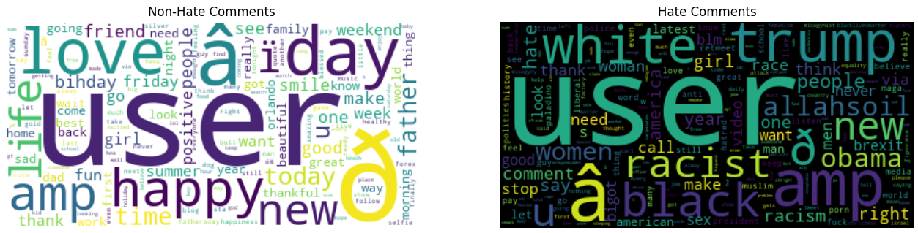
Textcloud of Common Words

Slide 8
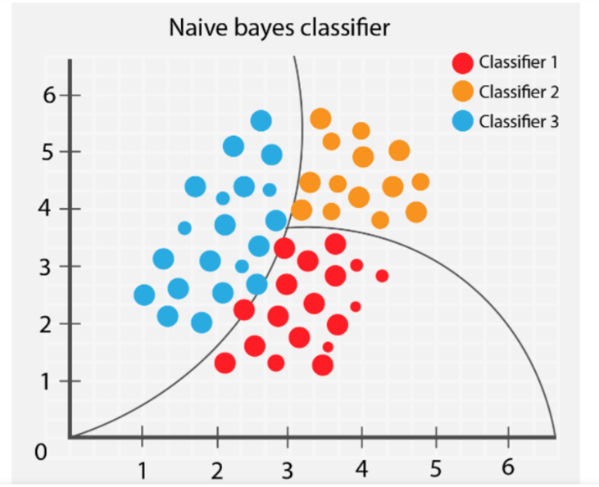
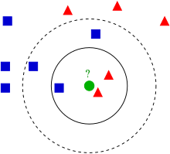
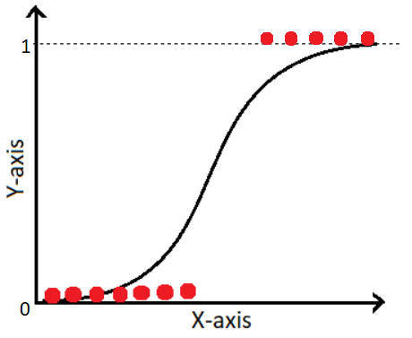
Proposed Models
1. K-Nearest Neighbour
2. Naïve Bayes
3. Logistic Regression

Slide 9
Thank You

